Slide 1
Supervised learning on hotel reviews score using regression
By Johnny Yap

Slide 2
Problem statement
Aim: To build a ML model that predicts the reviewer score of a given review using features from the review text and hotel details.
Objectives:
Conduct an EDA (exploratory data analysis) to investigate trends on the dataset
Investigate which features are important for training our model using correlation chart.
Compare results of basic regression algorithms i.e. RandomForestRegressor with more advanced algorithm i.e. XGBoost
Tune hyperparameters for XGBoost using Optuna, then compare results with default parameters for XGBoost

Slide 3
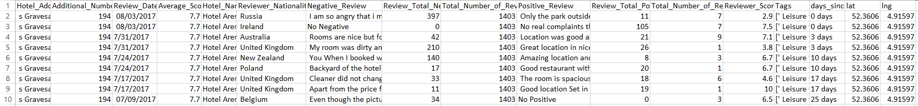
Dataset and parameters
Hotel reviews dataset scraped from booking.com in the year 2015-2017
The columns in the dataset are:
Hotel_Address
Additional_Number_of_Scoring
Review_Date
Average_Score
Hotel_Name
Reviewer_Nationality
Negative_Review
Review_Total_Negative_Word_Counts
Total_Number_of_Reviews
Positive_Review
Review_Total_Positive_Word_Counts
Total_Number_of_Reviews_Reviewer_Has_Given
Reviewer_Score
Tags
days_since_review
lat
lng

Slide 4
Exploratory Data Analysis

Slide 5
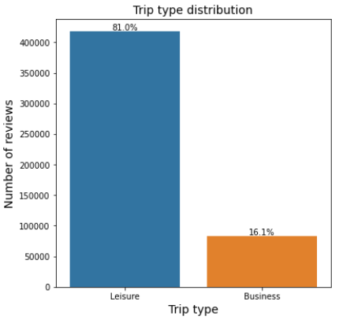
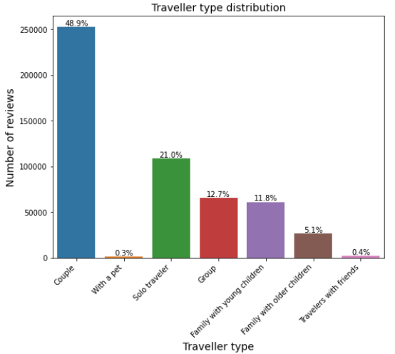
Out of the 515738 reviews in our dataset, here are some trends according to the tags on a review

Slide 6
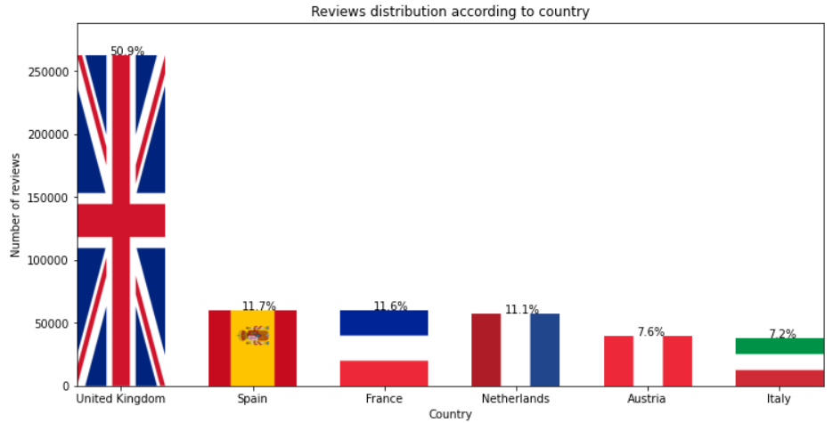
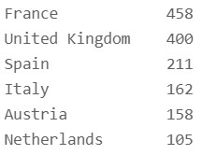
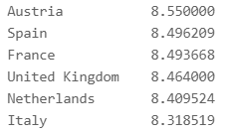
Country
of hotel
Number
of hotels
Country
of hotel
Mean of reviewer score
So what significance do all of these charts have, how do we find out how much influence they have on the reviewer score?
We can use a correlation chart between the features and the target, see slide 10.

Slide 7
First, let’s perform some
Sentiment Analysis

Slide 8
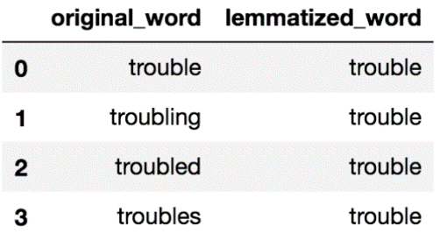
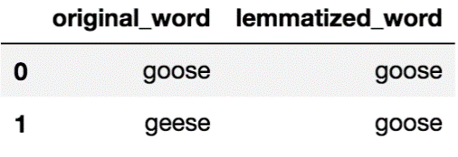
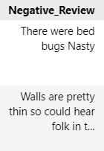
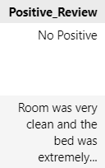
Preprocessing (Natural language processing)
Before we can perform sentiment analysis, we need to carry our some NLP for our sentiment analyser to work.
We perform natural language processing to remove stopwords
And reduce words to their root form through lemmatisation
Examples:
with stopwords | without stopwords
Blue car and blue window | Blue car blue window
Black crow in the window | Black crow window
I see my reflection in the window | see reflection window
Examples:
Next we combine the processed positive reviews and negative reviews into one text.
wall pretty thin could hear folk bathroom corridor room clean bed extremely comfortable breakfast excellent restaurant option around min walk

Slide 9
Sentiment analysis
Transform text into columns of sentiment values i.e. neg, neu, pos and compound, which machine can understand
review:
sentiment score:
room attic window roof felt closed coffee tea room restaurant hotel felt cold isolated accessible metro therefore easy access place interest

Slide 10
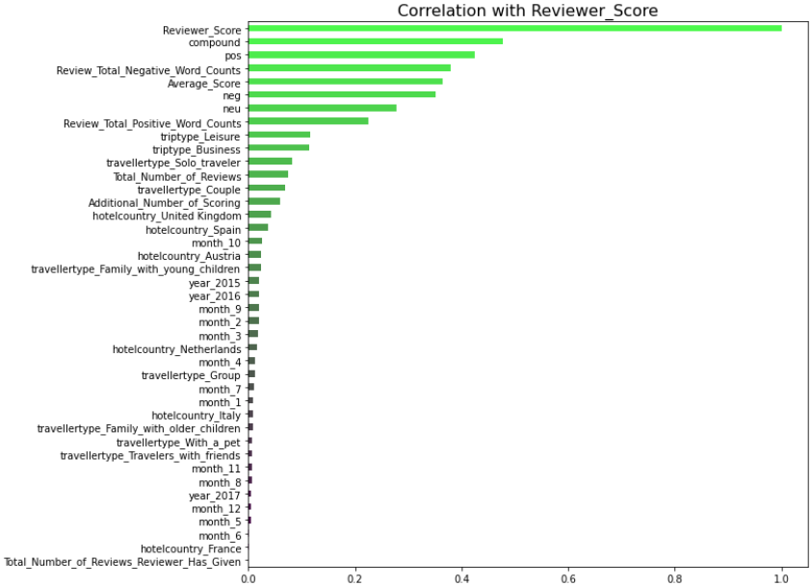
We use everything we have created so far to plot a correlation chart between our features to what we would like to predict i.e. reviewer_score
From the chart, we pick:
Review_Total_Negative_Word_Counts
Review_Total_Positive_Word_Counts
Average_Score
compound
as our features for training our machine learning model

Slide 11
Building and comparing
our ML models

Slide 12
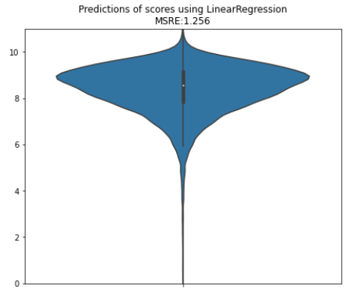
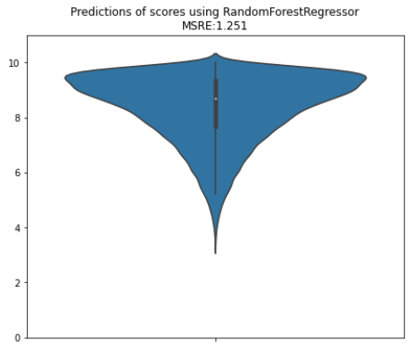
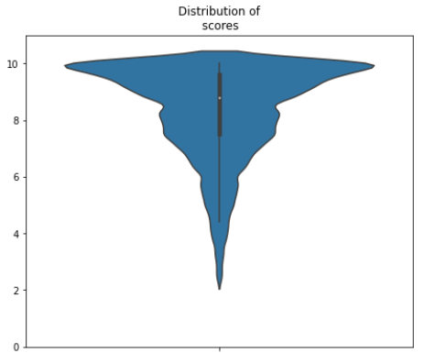
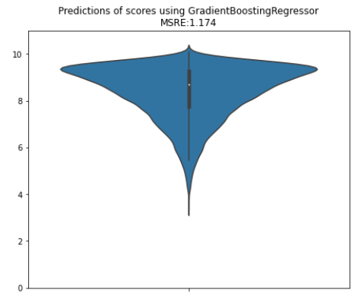
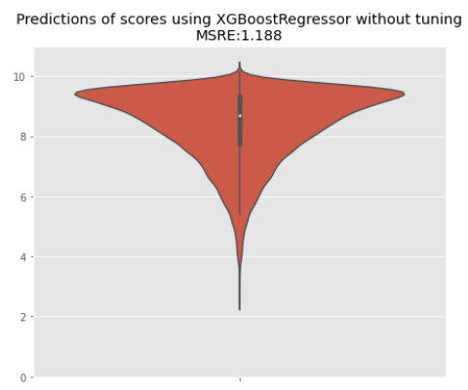
Using sentiment values, number of words and average score of hotel, we can predict the score of a given review.
We plot the predicted score distribution for 3 basic models
i.e. LinearRegression, RandomForestRegressor, and GradientBoostingRegressor.
We also plot for an advanced model i.e. XGBoost using default hyperparameters
We can try to improve our XGBoost model further by tuning its hyperparameters!

Slide 13
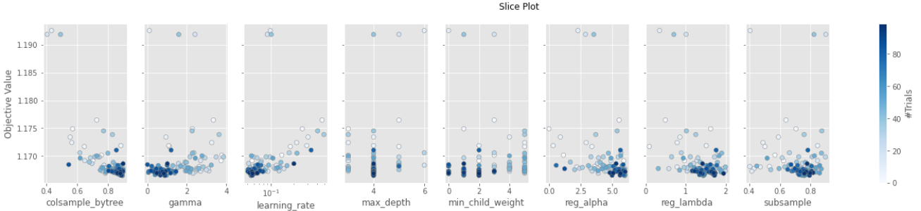

Hyperparameter tuning
Our objective value is root mean square error which we try to minimise
Best parameter =
{'max_depth': 4,
'reg_alpha': 5.968374987878846,
'reg_lambda': 1.4374979276040596, 'min_child_weight': 2,
'gamma': 0.8899280869658877,
'learning_rate': 0.05539358203635937,
'colsample_bytree': 0.8951338853974595,
'subsample': 0.7584140284053172}
XGBoost model

Slide 14
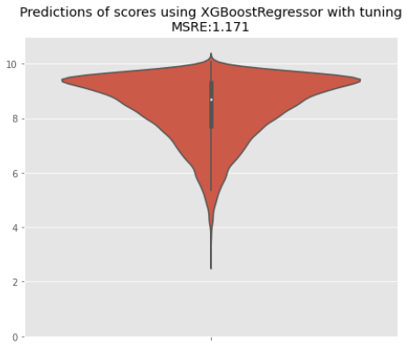
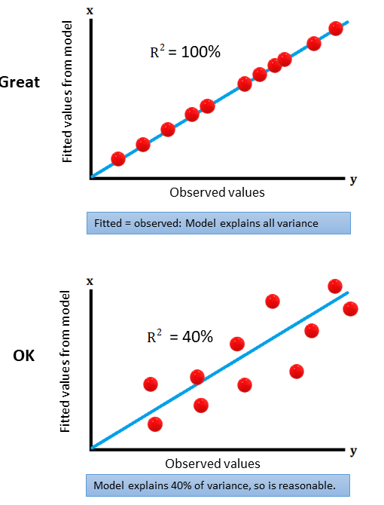
Final Model
k
Best model
RMSE: 1.171
R2 score: 0.494
Error rate: 0.104

Slide 15
Conclusion
We showed some EDA and observed some interesting trends
We observed from our correlation chart that sentiment values, number of words and average score of hotel are important for training our model.
After comparing the different models, XGBoost is the best regression model provided that we perform hyperparameter tuning.
Our model gave us a regression line that fits the actual data about 49% well.
Future Improvements:
Sentiment analyser could be improved as negative review like
“walls are pretty thin so could hear folk in their bathroom and in the corridor”
gives sentiment score of {'neg': 0.0, 'neu': 0.814, 'pos': 0.186, 'compound': 0.4939}
Best solution is to build our own sentiment analyser for specific context such as in this hotel reviews dataset.
Look at specific word mentioned in reviews (e.g. airconditioner, room, staff) and hot-encode them to see if they have high correlation with reviewer score
Maybe produce recommendation tags for each hotel e.g. lovely bed, spacious room, quiet streets, near city centre

Slide 16
Thank you for listening

